Slide 1

CS301 Phase 3: Final Presentation
Group: 12
Member(s): Arsh Parmar (jk2680)
Date: 05/02/2023
Course: CS 301
Instructor: Dr. Fay Zhong

Slide 2

Project Overview
This project aimed to develop a banking software using C++ language that offers user management, deposits, withdrawals, administrator, and money transfer functionalities. The initial version of the software was able to create and delete accounts, make deposits and withdrawals, and manage user information. However, I have recently added the administrator and money transfer functionalities to enhance the software's features.

Slide 3

Project Phases
Phase I
Planning and Design
Phase II
First Implementation
Phase III
Final Additions and Testing

Slide 4
Phase I highlight
In the first phase, I created a plan and design for the project, including the major functionalities to implement and established the timeframes for the completion. I also decided how I would implement the project, namely, using a C++ interface that communicates with the user and database.

Slide 5

Phase II highlight
In the second phase, I implemented the first half of the functionalities that I planned out (accounting and balances), meeting the set requirements. Along with that, I performed integration testing on the various modules I implemented.

Slide 6

Phase III highlight
In the third and final phase of the project, I implemented the final required functionalities of the project (admin and transfers), bank transfers and administration. This added multiple new modules to the project and led to more integration testing.

Slide 7

Development Details
Functionalities Implemented
User Management: Account creation and deletion (Phase II)
Deposits/Withdrawals: Adding and Deducting account balances (Phase II)
Admin: Access controls (regular users, administrators) (Phase III)
Transfer: Account to account transfer (Phase III)
Hidden Functionalities: Unique ID generation, Database Management

Slide 8
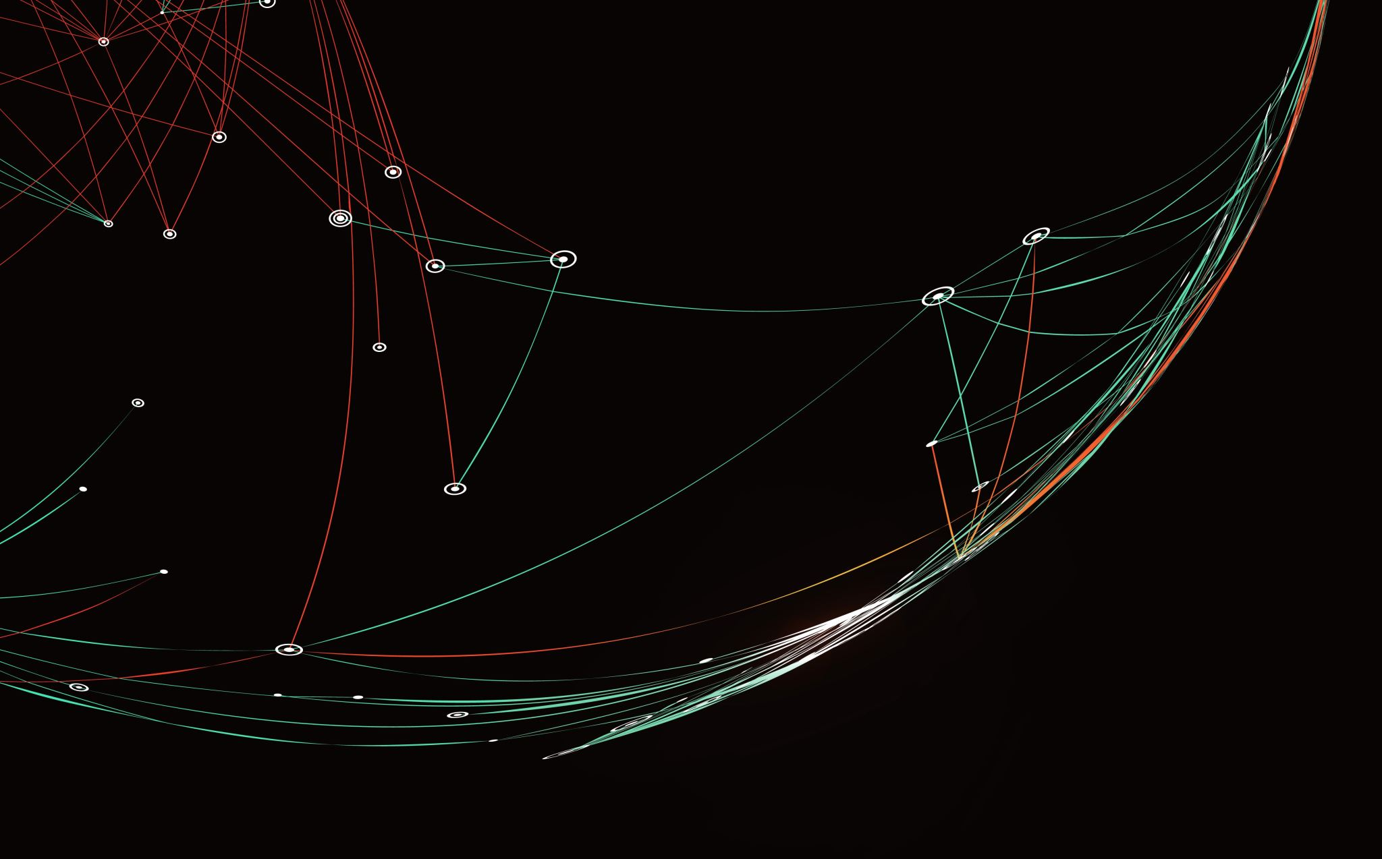
Interface: Transaction
bool depositBalanceFromNumber()
void depositBalance()
bool withdrawBalanceFromNumber()
void withdrawBalance()
void transfer()
This interface deals with movement of amounts to and fro accounts.

Slide 9
Interface: User Management
void createAccount()
void createAccountFromData()
void deleteAccount()
void deleteAccountFromNumber()
This interface deals with user account creation and deletion.

Slide 10
Interface: Admin
bool checkAdminStatus()
bool makeAdmin()
This interface deals with access controls. Administrators can exercise more control over the database with more functionalities.

Slide 11
Interface: Utilities
bool checkAccountNumberClash()
void displayAccounts()
vector<Account> readAccountsFromFile()
void writeAccountsToFile()
Account findAccount()
These are utilities to other essential interfaces.

Slide 12

Main Strength
The main strength of this project is its robustness. The interfaces can take in a multitude of inputs and perform well with corner cases. Extensive testing has ensured that there will be no errors faced when the software is being used.
Highlight: The unique ID generator ensures that no two accounts can have the same 7 digit integer ID, preventing database clashes.

Slide 13

Testing and Debugging
Integration Testing:
I performed integration testing of the software by testing the interaction between different modules. I tested interactions between
User management and deposits and withdrawals modules by creating accounts and making transactions, and verifying that the account balances are updated correctly.
User management and administrator functionality by logging in as an administrator, searching for and deleting accounts, and verifying that the account information is stored and deleted correctly.
Deposits and withdrawals and money transfer modules by transferring funds between accounts and verifying that the account balances are updated correctly.
User Acceptance Testing:
I invited friends to test the software and provide feedback. I provided them with tasks to perform, such as creating accounts, making transactions, logging in as an administrator, and transferring funds between accounts. I collected their feedback and made improvements to the software based on their suggestions.

Slide 14

Conclusion
To conclude, I successfully implemented a basic Banking Software using C++ that offers user management, deposits, withdrawals, administrator, and money transfer functionalities. The recent additions (administration and transfer) have enhanced the software’s features and made it more applicable.
This software can be enhanced further and a multitude of new features can be added to it, and exisiting features can be made more efficient.

